Slide 1
Slide 2
1536 x 600 pixel (15 x 40 cm)

Slide 2
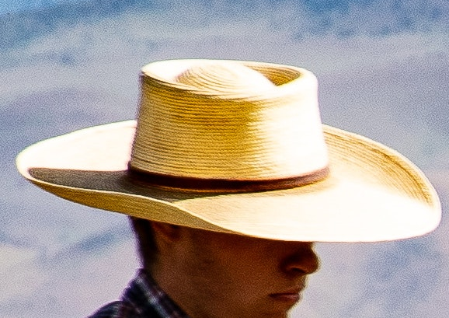
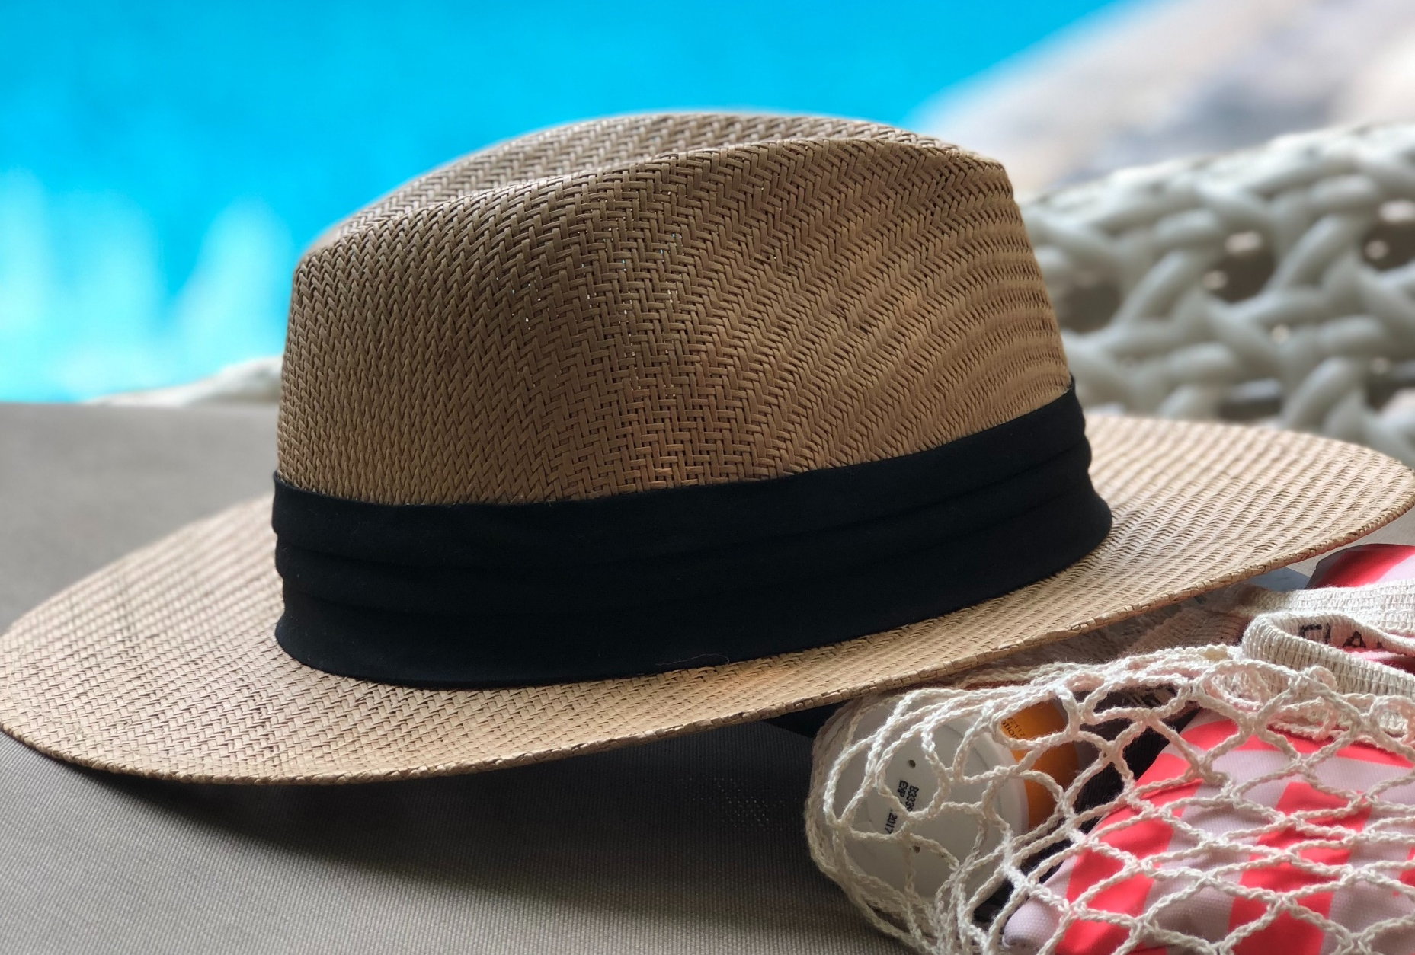
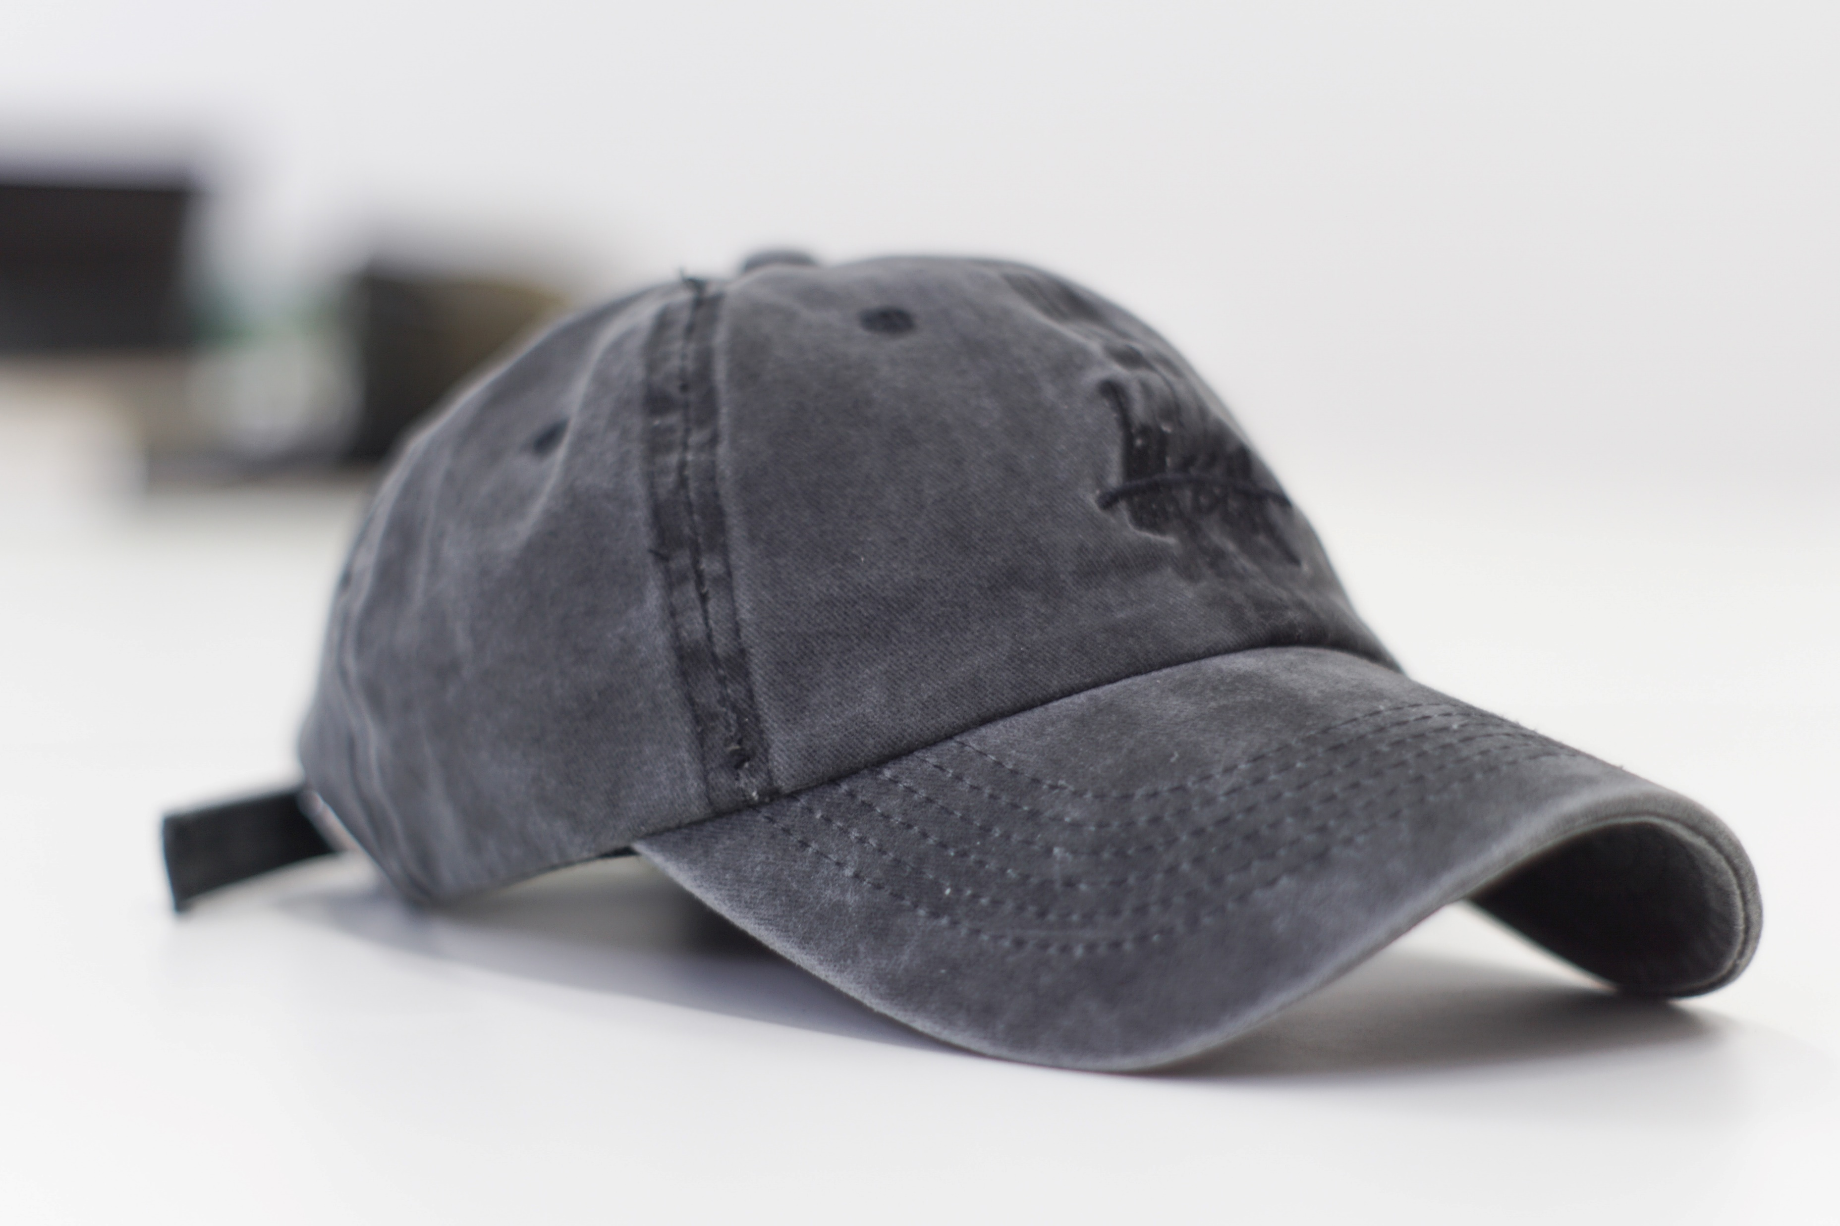

Rapley
Rapley
Rapley
Rapley

Slide 3
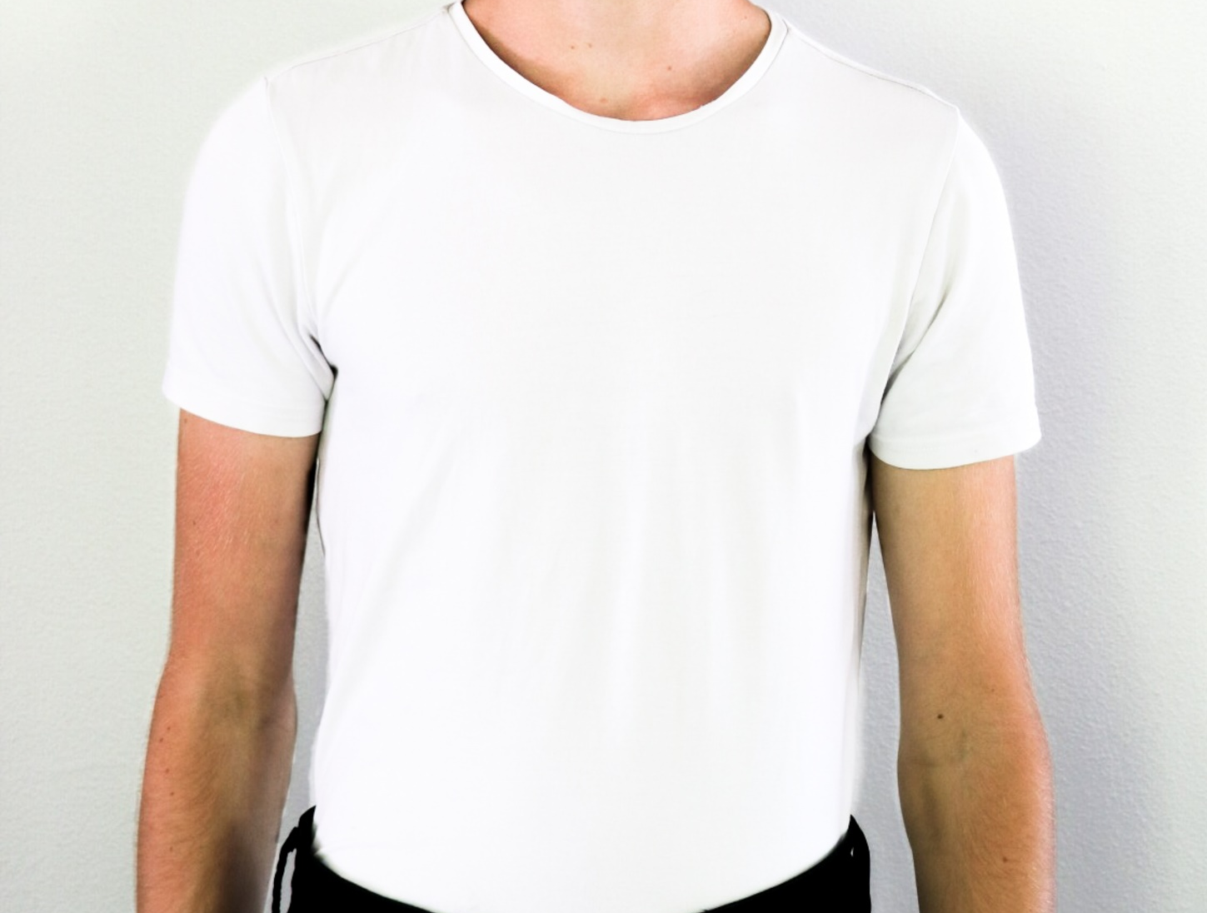
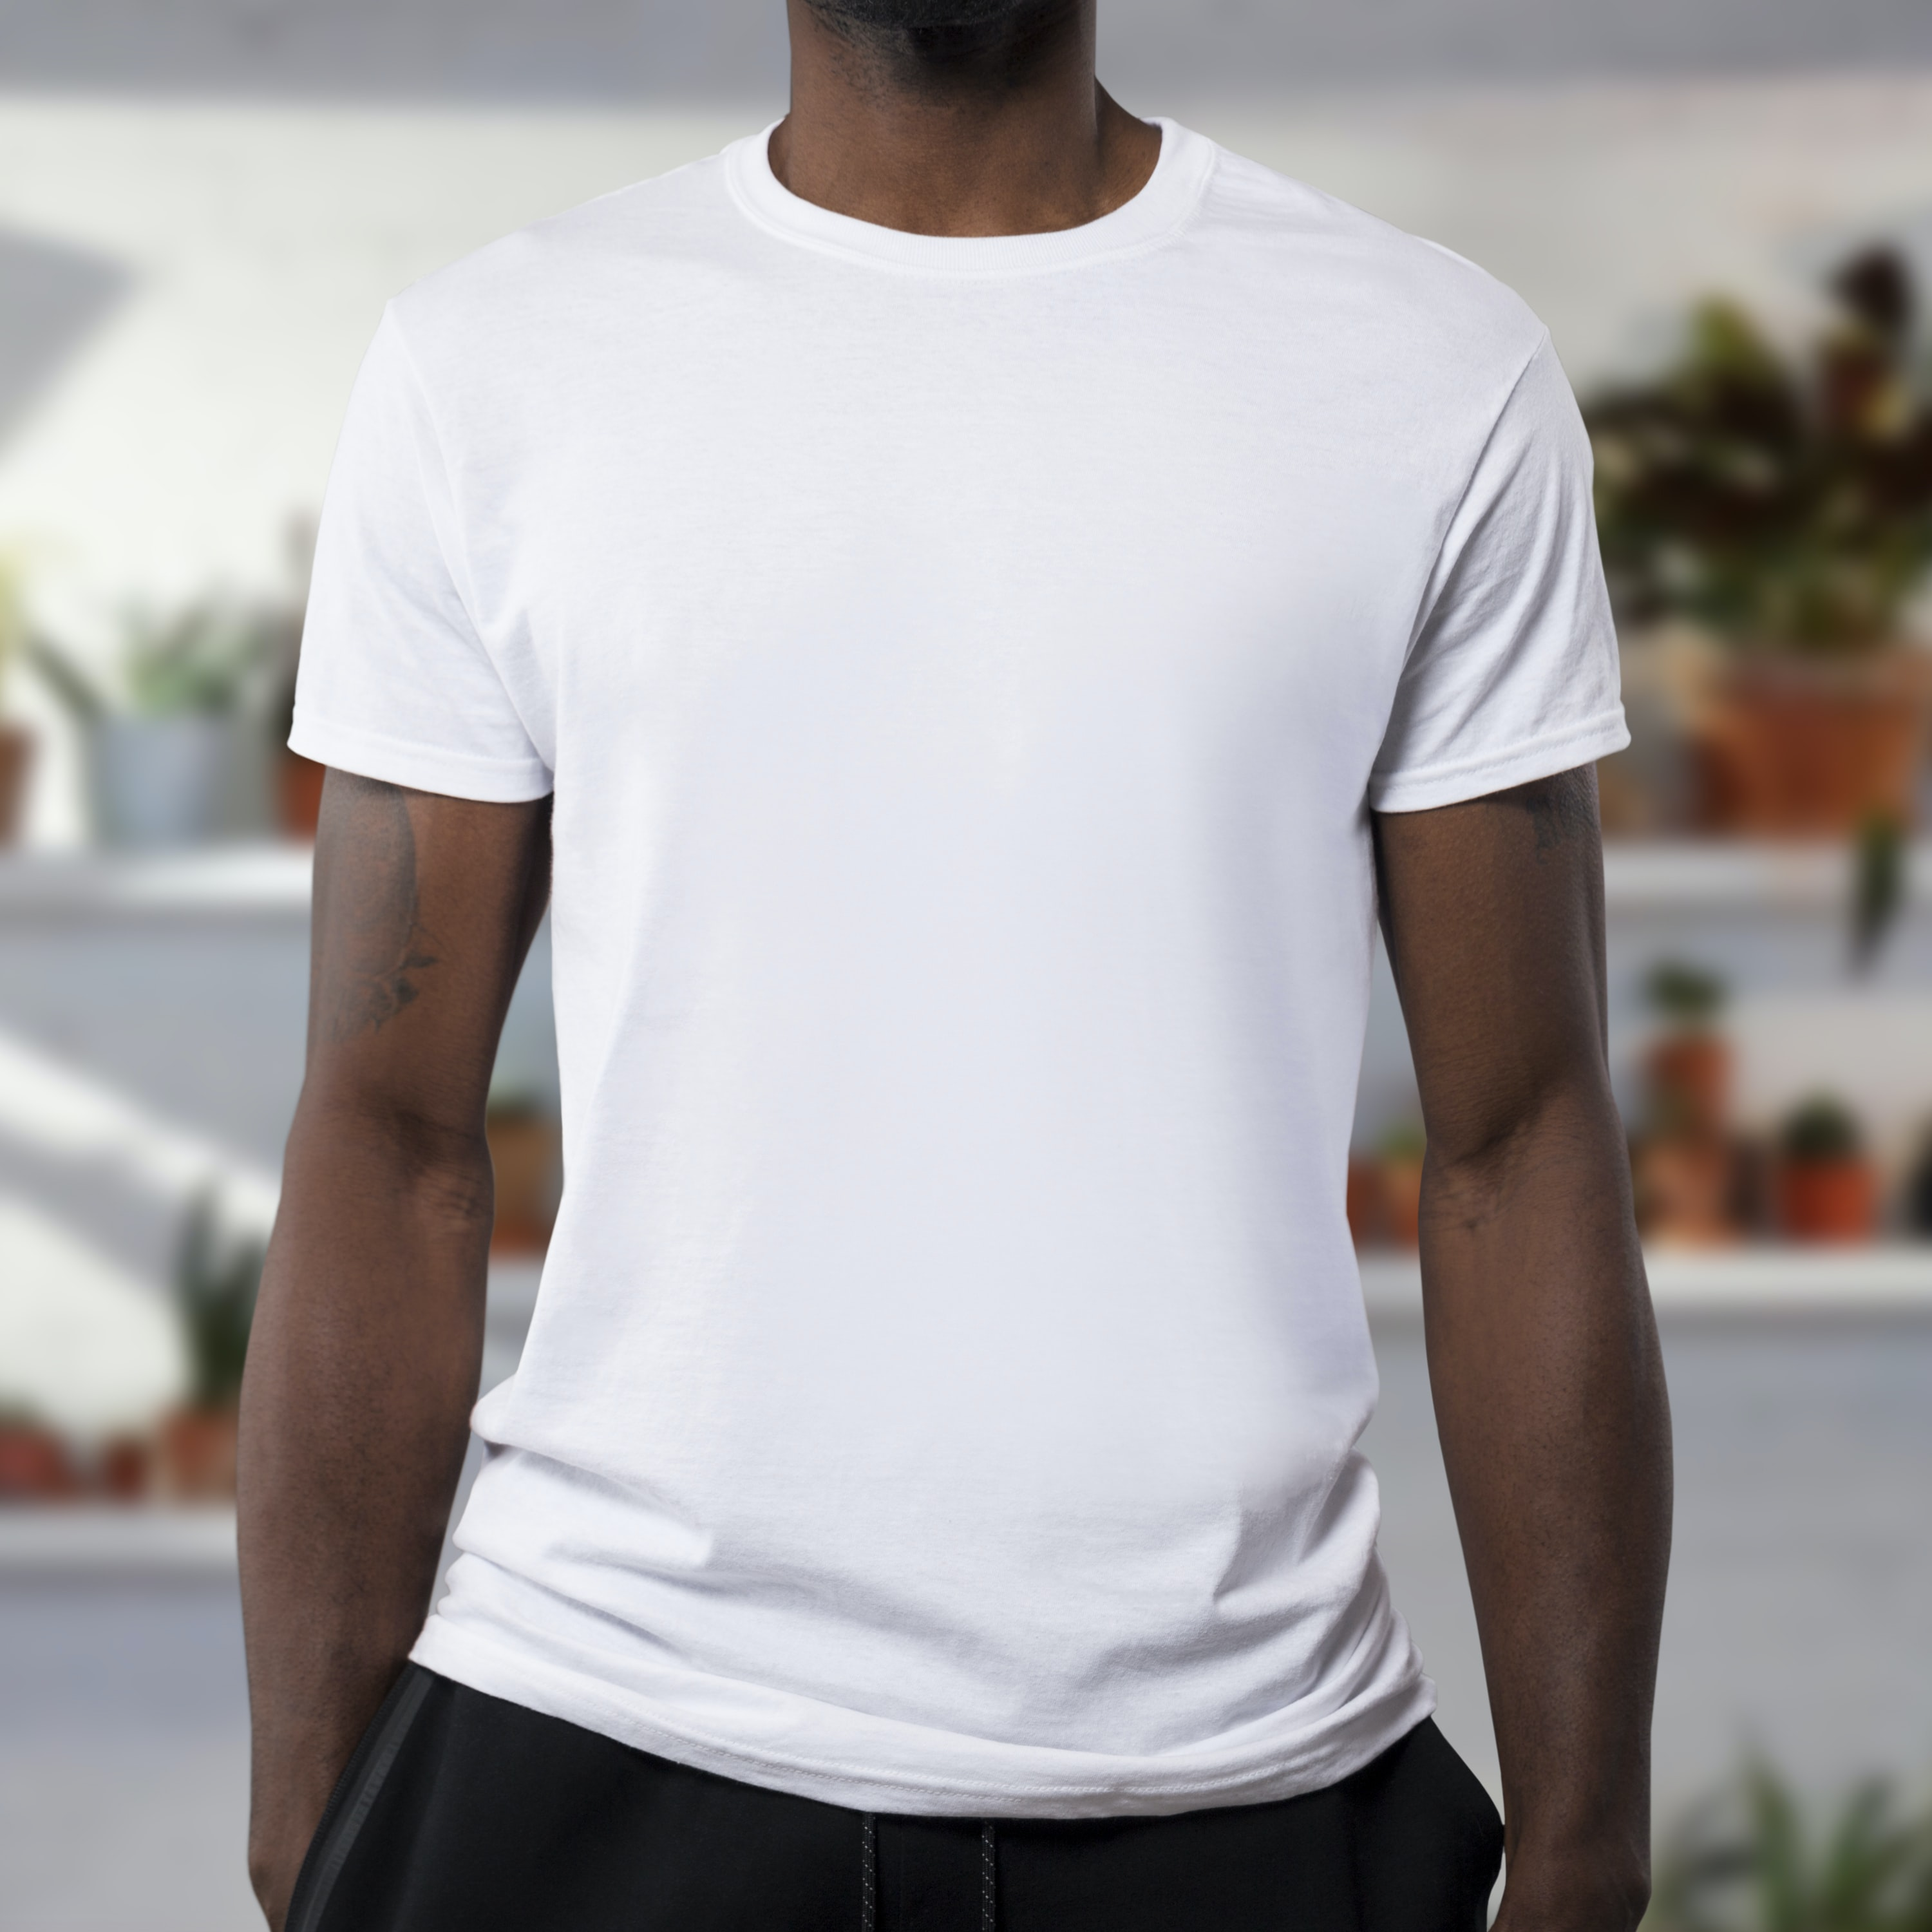


Rapley
Rapley
Rapley
Rapley

